Slide 1
DATA LINK CONTROL

Slide 2
Data Link Layer Design Issues
Services Provided to the Network Layer
Framing
Error Control
Flow Control

Slide 3
11-1 FRAMING
The data link layer needs to pack bits into frames, so that each frame is distinguishable from another. Our postal system practices a type of framing. The simple act of inserting a letter into an envelope separates one piece of information from another; the envelope serves as the delimiter.
Topics discussed in this section:
Fixed-Size Framing
Variable-Size Framing

Slide 4
Types of Framing
Fixed Size Framing
Variable Size Framing--- Character oriented protocols and Bit oriented Protocols.

Slide 5

Figure 11.1 A frame in a character-oriented protocol

Slide 6

Figure 11.2 Byte stuffing and unstuffing

Slide 7

Note
Byte stuffing is the process of adding 1 extra byte whenever there is a flag or escape character in the text.

Slide 8

Figure 11.3 A frame in a bit-oriented protocol

Slide 9
Note
Bit stuffing is the process of adding one extra 0 whenever five consecutive 1s follow a 0 in the data, so that the receiver does not mistake
the pattern 0111110 for a flag.

Slide 10

Figure 11.4 Bit stuffing and unstuffing

Slide 11
11-2 FLOW AND ERROR CONTROL
The most important responsibilities of the data link layer are flow control and error control. Collectively, these functions are known as data link control.
Topics discussed in this section:
Flow Control
Error Control

Slide 12
Note
Flow control refers to a set of procedures used to restrict the amount of data
that the sender can send before
waiting for acknowledgment.

Slide 13
Note
Error control in the data link layer is based on automatic repeat request, which is the retransmission of data.

Slide 14

Figure 11.5 Taxonomy of protocols discussed in this chapter

Slide 15
11-4 NOISELESS CHANNELS
Let us first assume we have an ideal channel in which no frames are lost, duplicated, or corrupted. We introduce two protocols for this type of channel.
Topics discussed in this section:
Simplest Protocol
Stop-and-Wait Protocol

Slide 16

Figure 11.6 The design of the simplest protocol with no flow or error control

Slide 17

Figure 11.7 Flow diagram for Example 11.1

Slide 18
Stop-and-Wait Protocol
Sender sends one frame, stops until it gets confirmation from receiver.

Slide 19

Figure 11.8 Design of Stop-and-Wait Protocol

Slide 20

Figure 11.9 Flow diagram for Example 11.2

Slide 21
11-5 NOISY CHANNELS
Although the Stop-and-Wait Protocol gives us an idea of how to add flow control to its predecessor, noiseless channels are nonexistent. We discuss three protocols in this section that use error control.
Topics discussed in this section:
Stop-and-Wait Automatic Repeat Request
Go-Back-N Automatic Repeat Request
Selective Repeat Automatic Repeat Request

Slide 22
Note
Error correction in Stop-and-Wait ARQ is done by keeping a copy of the sent frame and retransmitting of the frame when the timer expires.

Slide 23
Note
In Stop-and-Wait ARQ, we use sequence numbers to number the frames.
The sequence numbers are based on modulo-2 arithmetic.

Slide 24
Note
In Stop-and-Wait ARQ, the acknowledgment number always announces in modulo-2 arithmetic the sequence number of the next frame expected.

Slide 25

Figure 11.10 Design of the Stop-and-Wait ARQ Protocol

Slide 26

Figure 11.11 Flow diagram for Example 11.3

Slide 27
Disadvantage Stop-and-Wait ARQ Protocol
Inefficient---if channel is thick and long
Thick means high bandwidth
Long means roundtrip delay
Product of both is bandwidth delay.
Bandwidth delay is number of bits we can send while waiting for news from receiver.

Slide 28
Example 11.4
Assume that, in a Stop-and-Wait ARQ system, the bandwidth of the line is 1 Mbps, and 1 bit takes 20 ms to make a round trip. What is the bandwidth-delay product? If the system data frames are 1000 bits in length, what is the utilization percentage of the link?
Solution
The bandwidth-delay product is
11.<number>

Slide 29
Example 11.4 (continued)
The system can send 20,000 bits during the time it takes for the data to go from the sender to the receiver and then back again. However, the system sends only 1000 bits. We can say that the link utilization is only 1000/20,000, or 5 percent. For this reason, for a link with a high bandwidth or long delay, the use of Stop-and-Wait ARQ wastes the capacity of the link.
11.<number>

Slide 30
Pipelining
Task begins before end of first task.
Stop-and-Wait ARQ does not use pipelining but other two techniques do.
This improves efficiency.

Slide 31
Go-Back-N Protocol
This sends multiple frames before receiving acknowledgment from receiver.

Slide 32
Note
In the Go-Back-N Protocol, the sequence numbers are modulo 2^{m},
where m is the size of the sequence number field in bits.

Slide 33
Sliding Window
Defines the range of sequence numbers that is concern of sender and receiver.
The range which is concern of sender is called sender sliding window.
The range which is concern of receiver is called receiver sliding window.

Slide 34

Figure 11.12 Send window for Go-Back-N ARQ

Slide 35
Note
The send window is an abstract concept defining an imaginary box of size 2^{m} − 1 with three variables: Sf, Sn, and S_{size}.

Slide 36
Note
The send window can slide one
or more slots when a valid acknowledgment arrives.

Slide 37

Figure 11.13 Receive window for Go-Back-N ARQ

Slide 38
Note
The receive window is an abstract concept defining an imaginary box
of size 1 with one single variable R_{n}.
The window slides
when a correct frame has arrived; sliding occurs one slot at a time.

Slide 39
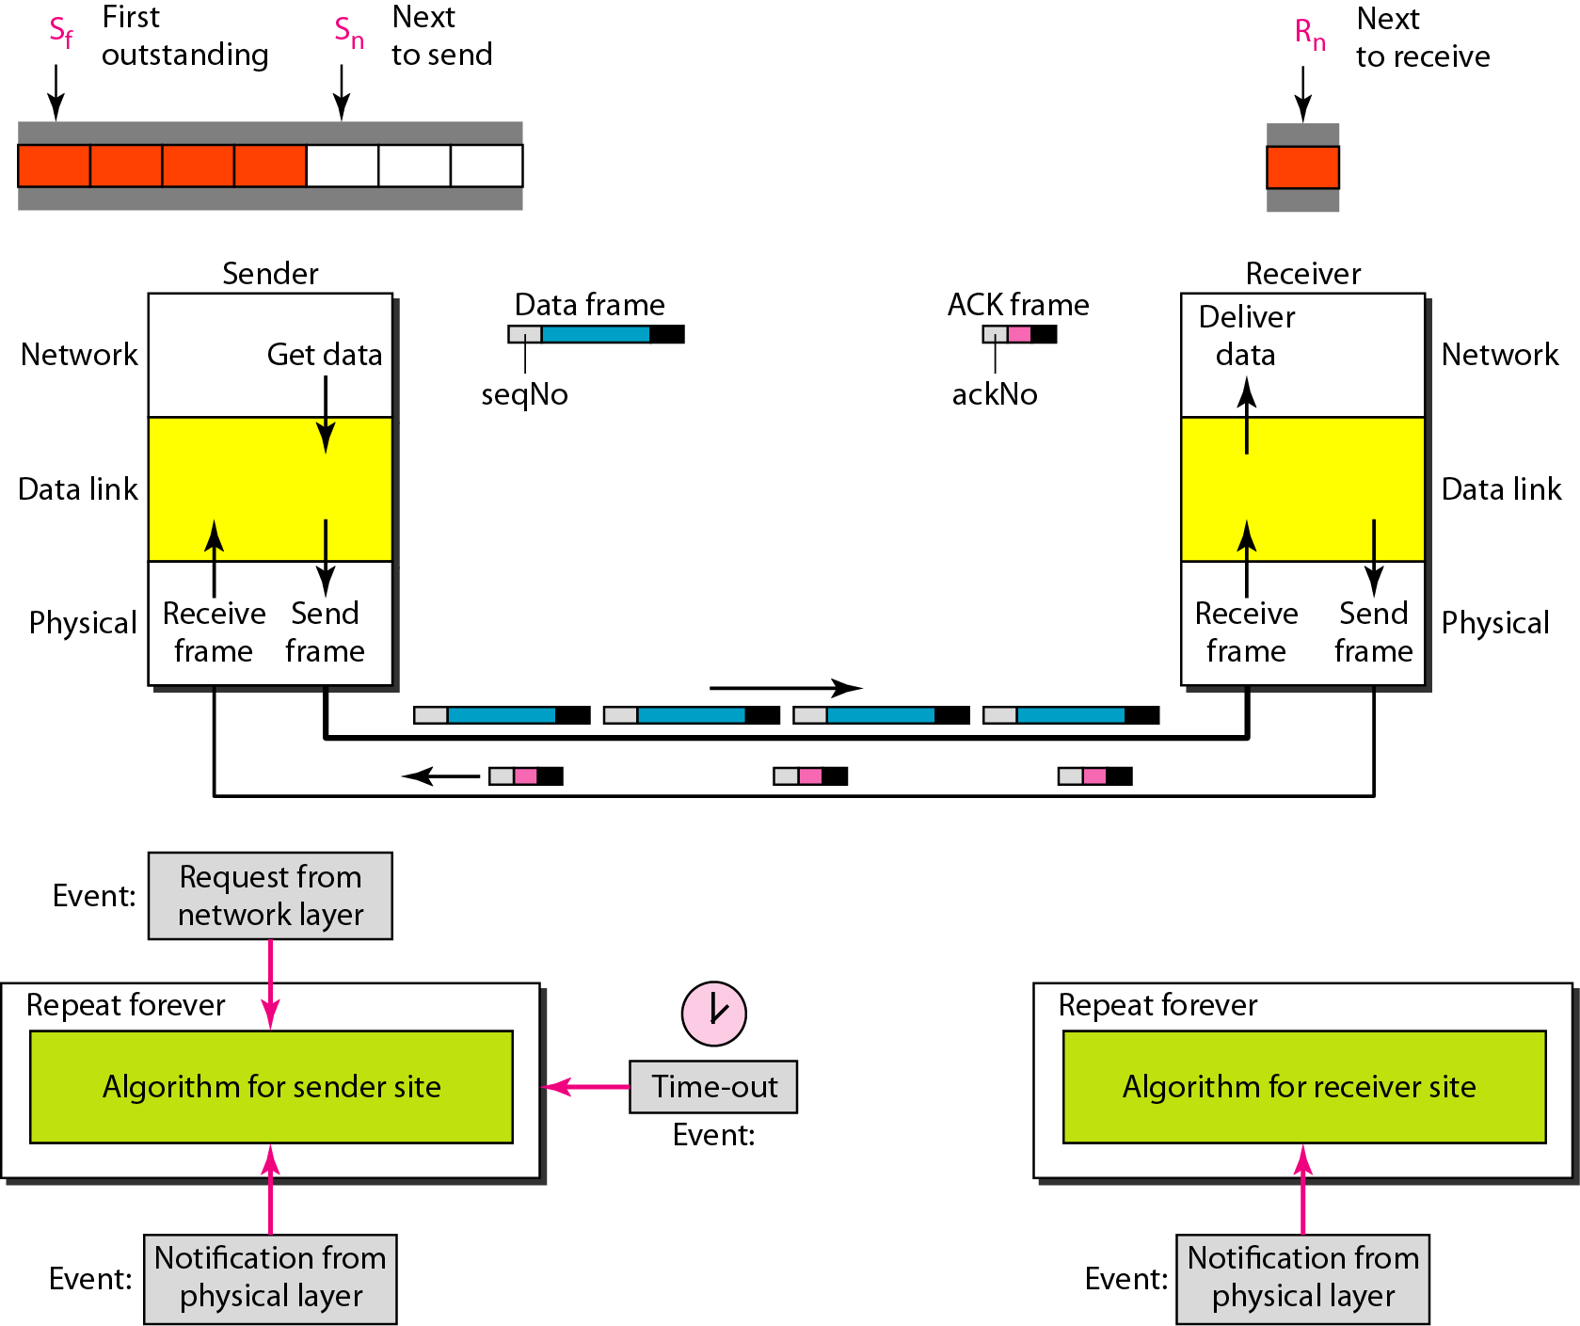
Figure 11.14 Design of Go-Back-N ARQ

Slide 40

Figure 11.15 Window size for Go-Back-N ARQ

Slide 41
Note
In Go-Back-N ARQ, the size of the send window must be less than 2^{m};
the size of the receiver window
is always 1.

Slide 42

Figure 11.16 Flow diagram for Example 11.6

Slide 43

Figure 11.17 Flow diagram for Example 11.7

Slide 44
Note
Stop-and-Wait ARQ is a special case of Go-Back-N ARQ in which the size of the send window is 1.

Slide 45

Figure 11.18 Send window for Selective Repeat ARQ

Slide 46

Figure 11.19 Receive window for Selective Repeat ARQ

Slide 47
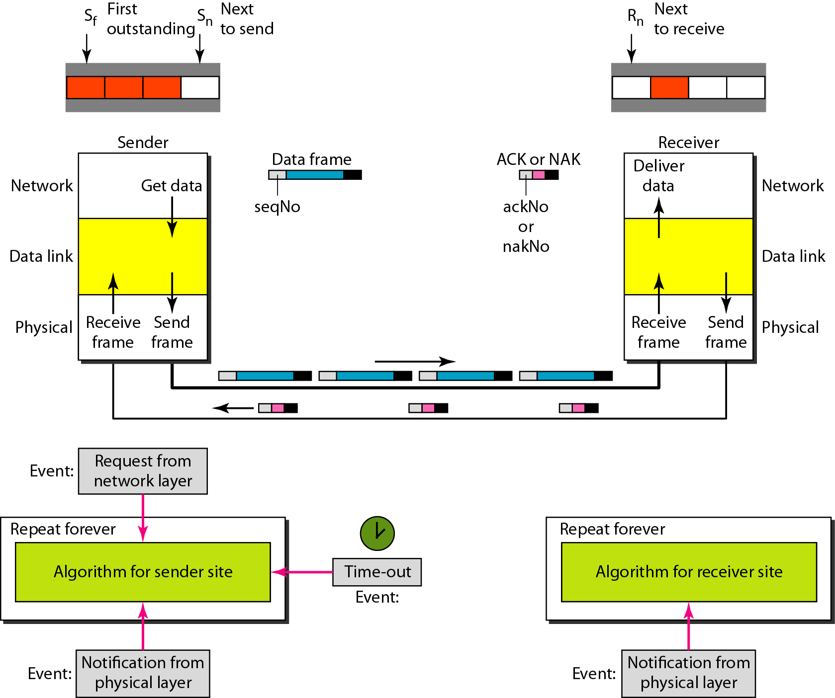
Figure 11.20 Design of Selective Repeat ARQ

Slide 48

Figure 11.21 Selective Repeat ARQ, window size

Slide 49
Note
In Selective Repeat ARQ, the size of the sender and receiver window
must be at most one-half of 2^{m}.

Slide 50

Figure 11.22 Delivery of data in Selective Repeat ARQ

Slide 51

Figure 11.23 Flow diagram for Example 11.8

Slide 52
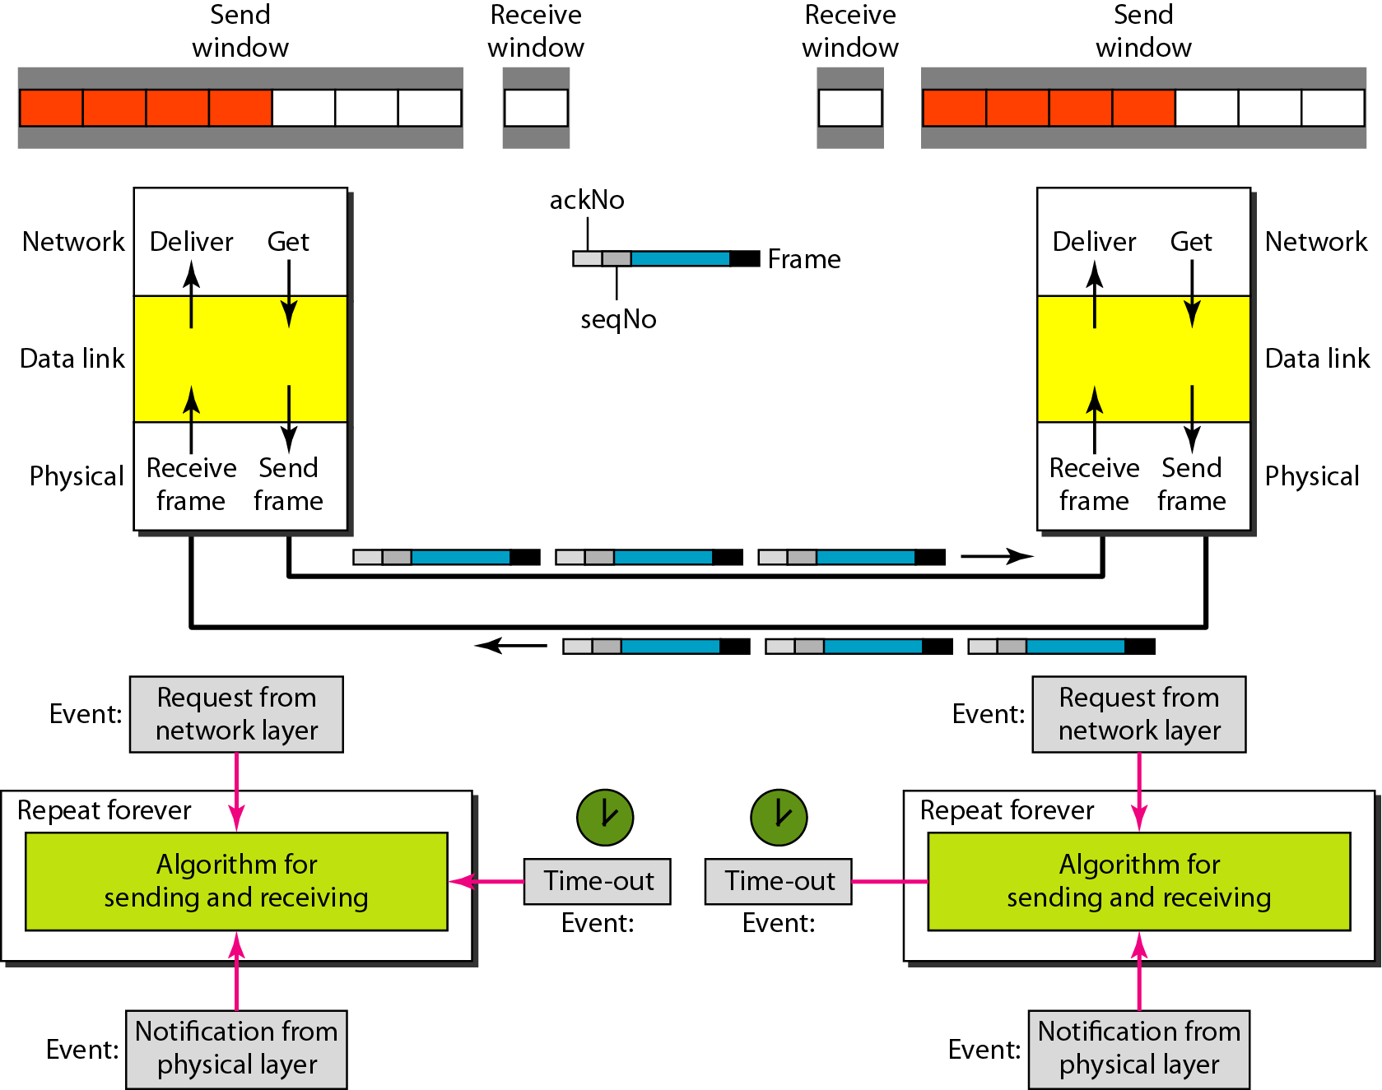
Figure 11.24 Design of piggybacking in Go-Back-N ARQ

